Slide 1
K Nearest Neighbour

Slide 2
Objectives
After completing this module, you should be able to understand:
K Nearest Neighbour
1 Nearest Neighbour for Classification
1 nearest Neighbour for Regression
Model Complexity
Overfitting

Slide 3
K Nearest Neighbours
Conceptually one of the simplest Machine Learning algorithms.
Uses the proximity or similarity of observations to make predictions about them
Method:
For the 1-Nearest Neighbour algorithm, find the closest labelled observation to the unlabelled observation and apply the same label.
For k Nearest Neighbour, find k closest labelled data points, take majority vote.
While it may seem very simple, it is often very effective!
It can be used for classification or regression

Slide 4
1 Nearest Neighbour predictions

Slide 5
1 Nearest Neighbour predictions
?

Slide 6
1 Nearest Neighbour predictions

Slide 7
1 Nearest Neighbour predictions
?

Slide 8
1 Nearest Neighbour predictions

Slide 9
1 Nearest Neighbour predictions
?

Slide 10
1 Nearest Neighbour predictions
Here there is some ambiguity. We are equal distance from both classes.
In this case, for 1-NN we would just flip a coin to choose a class at random
?

Slide 11
Regression 1 Nearest Neighbour predictions
6
5
6
8
?
1.5
3
0

Slide 12
Regression 1 Nearest Neighbour predictions
6
5
6
8
8
1.5
3
0

Slide 13
Model complexity
Larger k = smoother decision boundary = less complex model
Smaller k = more complex model = can lead to overfitting

Slide 14
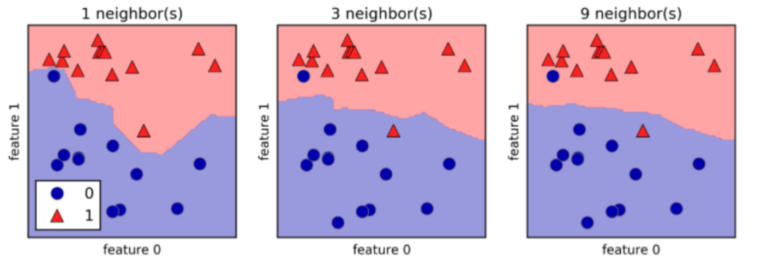
Model complexity

Slide 15
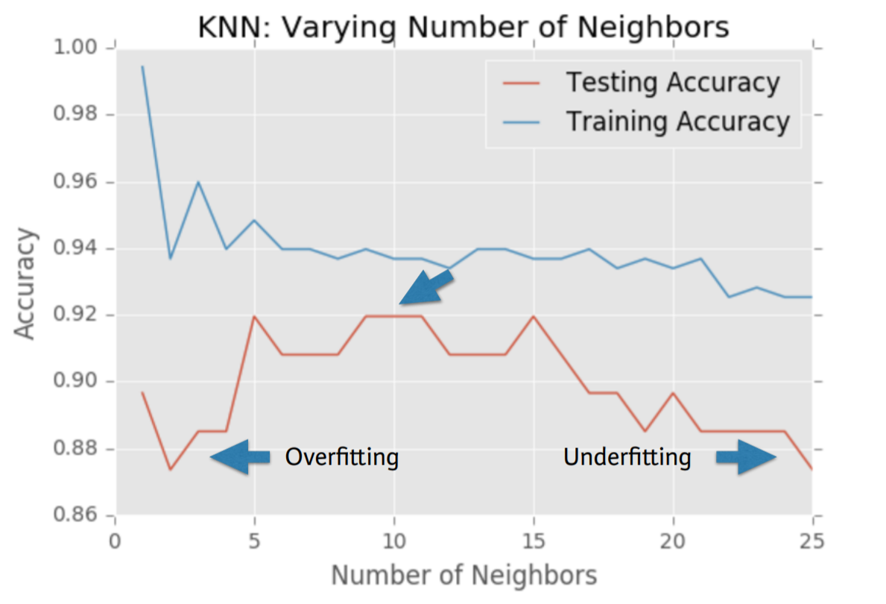
Model complexity and Overfitting/Underfitting

Slide 16
Summary
This module covered the following topics:
K Nearest Neighbour
1 Nearest Neighbour for Classification
1 nearest Neighbour for Regression
Model Complexity
Overfitting

Slide 17
Thank you

